Slide 1
Chapter 4
Multiple Regression Analysis
(Part 2)
Terry Dielman
Applied Regression Analysis:
A Second Course in Business and Economic Statistics, fourth edition
Multiple Regression II
Copyright © 2005 Brooks/Cole, a division of Thomson Learning, Inc.

Slide 2
4.4 Comparing Two Regression Models
So far we have looked at two types of hypothesis tests. One was about the overall fit:
H₀: β₁ = β₂ = …= β_{K} = 0
The other was about individual terms:
H₀: β_{j} = 0
H_{a}: β_{j} ≠ 0
Multiple Regression II
Copyright © 2005 Brooks/Cole, a division of Thomson Learning, Inc.

Slide 3
4.4.1 Full and Reduced Model Using Separate Regressions
Suppose we wanted to test a subset of the x variables for significance as a group.
We could do this by comparing two models.
The first (Full Model) has K variables in it.
The second (Reduced Model) contains only the L variables that are NOT in our group.
Multiple Regression II
Copyright © 2005 Brooks/Cole, a division of Thomson Learning, Inc.

Slide 4
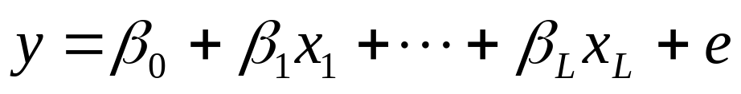
The Two Models
For convenience, let's assume the group is the last (K-L) variables. The Full Model is:
The Reduced Model is just:
Multiple Regression II
Copyright © 2005 Brooks/Cole, a division of Thomson Learning, Inc.

Slide 5
The Partial F Test
We test the group for significance with another F test. The hypothesis is:
H₀: β_{L+1} = β_{L+2} = …= β_{K} = 0
H_{a}: At least one β ≠ 0
The test is performed by seeing how much SSE changes between models.
Multiple Regression II
Copyright © 2005 Brooks/Cole, a division of Thomson Learning, Inc.

Slide 6
The Partial F Statistic
Let SSE_{F} and SSE_{R} denote the SSE in the full and reduced models.
(SSE_{R} – SSE_{F}) / (K – L)
F =
SSE_{F} / (n-K-1)
The statistic has (K-L) numerator and (n-K-1) denominator d.f.
Multiple Regression II
Copyright © 2005 Brooks/Cole, a division of Thomson Learning, Inc.

Slide 7
The "Group"
In many problems the group of variables has a natural definition.
In later chapters we look at groups that provide curvature, measure location and model seasonal variation.
Here we are just going to look at the effect of adding two new variables.
Multiple Regression II
Copyright © 2005 Brooks/Cole, a division of Thomson Learning, Inc.

Slide 8
Example 4.4 Meddicorp (yet again)
In addition to the variables for advertising and bonuses paid, we now consider variables for market share and competition.
x₃ = Meddicorp market share in each area
x₄ = largest competitor's sales in each area
Multiple Regression II
Copyright © 2005 Brooks/Cole, a division of Thomson Learning, Inc.

Slide 9
The New Regression Model
The regression equation is
SALES = - 594 + 2.51 ADV + 1.91 BONUS + 2.65 MKTSHR - 0.121 COMPET
Predictor Coef SE Coef T P
Constant -593.5 259.2 -2.29 0.033
ADV 2.5131 0.3143 8.00 0.000
BONUS 1.9059 0.7424 2.57 0.018
MKTSHR 2.651 4.636 0.57 0.574
COMPET -0.1207 0.3718 -0.32 0.749
S = 93.77 R-Sq = 85.9% R-Sq(adj) = 83.1%
Analysis of Variance
Source DF SS MS F P
Regression 4 1073119 268280 30.51 0.000
Residual Error 20 175855 8793
Total 24 1248974
Multiple Regression II
Copyright © 2005 Brooks/Cole, a division of Thomson Learning, Inc.

Slide 10
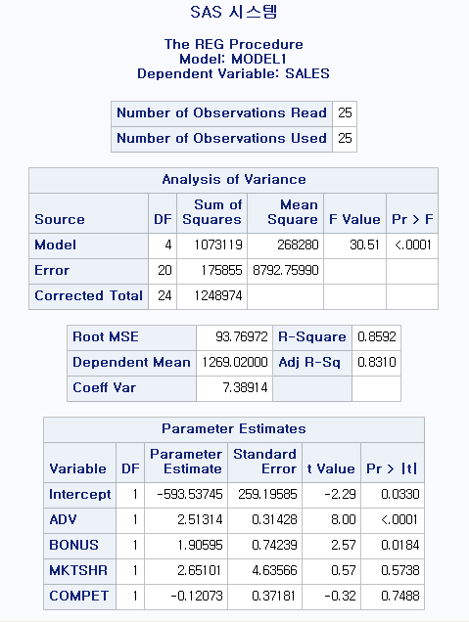
PROC REG;
MODEL SALES = ADV BONUS MKTSHR COMPET;
RUN:
Multiple Regression II
Copyright © 2005 Brooks/Cole, a division of Thomson Learning, Inc.

Slide 11
Did We Gain Anything?
The old model had R² = 85.5% so we gained only .4%.
The t ratios for the two new variables are .57 and -.32.
It does not look like we have an improvement, but we really need the F test to be sure.
Multiple Regression II
Copyright © 2005 Brooks/Cole, a division of Thomson Learning, Inc.

Slide 12
The Formal Test
Numerator df = (K-L) = 4-2 = 2
Denominator df = (n-K-1) = 20
At a 5% level, F_{2,20} = 3.49
H₀: β_{MKTSHR} = β_{COMPET} = 0
H_{a}: At least one is ≠ 0
Reject H₀ if F > 3.49
Multiple Regression II
Copyright © 2005 Brooks/Cole, a division of Thomson Learning, Inc.

Slide 13
Things We Need
Full Model: (K = 4)
SSE_{F} = 175855
(n-K-1) = 20
Reduced Model: (L = 2)
SSE_{R}
Analysis of Variance
Source DF SS MS F P
Regression 2 1067797 533899 64.83 0.000
Residual Error 22 181176 8235
Total 24 1248974
Multiple Regression II
Copyright © 2005 Brooks/Cole, a division of Thomson Learning, Inc.

Slide 14
Computations
(SSE_{R} – SSE_{F}) / (K – L)
F =
SSE_{F} / (n-K-1)
(181176 – 175855)/ (4 – 2)
=
175855 / (25-4-1)
5321/2
= = .3026
8793
Multiple Regression II
Copyright © 2005 Brooks/Cole, a division of Thomson Learning, Inc.

Slide 15
4.4.2 Full and Reduced Model Comparisons Using Conditional Sums of Squares
In the standard ANOVA table, SSR shows the amount of variation explained by all variables together.
Alternate forms of the table break SSR down into components.
For example, Minitab shows sequential SSR which shows how much SSR increases as each new term is added.
Multiple Regression II
Copyright © 2005 Brooks/Cole, a division of Thomson Learning, Inc.

Slide 16
Sequential SSR for Meddicorp
S = 93.77 R-Sq = 85.9% R-Sq(adj) = 83.1%
Analysis of Variance
Source DF SS MS F P
Regression 4 1073119 268280 30.51 0.000
Residual Error 20 175855 8793
Total 24 1248974
Source DF Seq SS
ADV 1 1012408
BONUS 1 55389
MKTSHR 1 4394
COMPET 1 927
Multiple Regression II
Copyright © 2005 Brooks/Cole, a division of Thomson Learning, Inc.

Slide 17
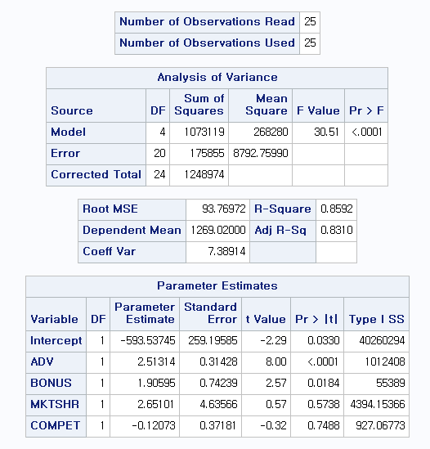
PROC REG;
MODEL SALES = ADV BONUS MKTSHR COMPET / SS1 ;
RUN:
Multiple Regression II
Copyright © 2005 Brooks/Cole, a division of Thomson Learning, Inc.

Slide 18
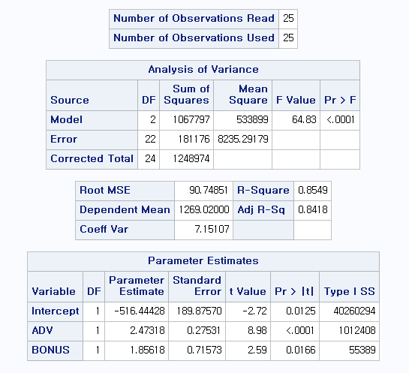
PROC REG;
MODEL SALES = ADV BONUS / SS1 ;
RUN:
Multiple Regression II
Copyright © 2005 Brooks/Cole, a division of Thomson Learning, Inc.

Slide 19
Meaning What?
If ADV was added to the model first, SSR would rise from 0 to 1012408.
Addition of BONUS would yield a nice increase of 55389.
If MKTSHR entered third, SSR would rise a paltry 4394.
Finally, if COMPET came in last, SSR would barely budge by 927.
Multiple Regression II
Copyright © 2005 Brooks/Cole, a division of Thomson Learning, Inc.

Slide 20
Implications
This is another way of showing that once you account for advertising and bonuses paid, you do not get much more from the last two variables.
The last two sequential SSR values add up to 5321, which was the same as the (SSE_{R} – SSE_{F}) quantity computed in the partial F test.
Given that, it is not surprising to learn that the partial F test can be stated in terms of sequential sums of squares.
Multiple Regression II
Copyright © 2005 Brooks/Cole, a division of Thomson Learning, Inc.

Slide 21
4.5 Prediction With a Multiple Regression Equation
As in simple regression, we will look at two types of computations:
  Estimating the mean y that can occur at a set of x values.
  Predicting an individual value of y that can occur at a set of x values.
Multiple Regression II
Copyright © 2005 Brooks/Cole, a division of Thomson Learning, Inc.

Slide 22
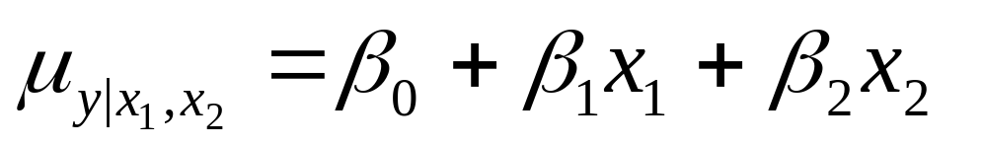
4.5.1 Estimating the Conditional Mean of y Given x₁, x₂, ..., x_{K}
This is our estimate of the point on our regression surface that occurs at a specific set of x values.
For two x variables, we are estimating:
Multiple Regression II
Copyright © 2005 Brooks/Cole, a division of Thomson Learning, Inc.

Slide 23
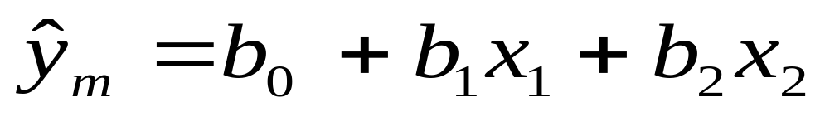
Computations
The point estimate is straightforward, just plug in the x values.
The difficult part is computing a standard error to use in a confidence interval. Thankfully, most computer programs can do that.
Multiple Regression II
Copyright © 2005 Brooks/Cole, a division of Thomson Learning, Inc.

Slide 24
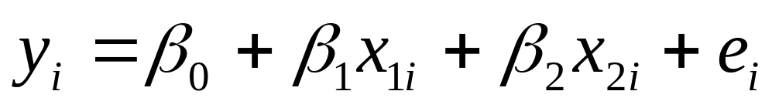
4.5.2 Predicting an Individual Value of y Given x₁, x₂, ..., x_{K}
Now the quantity we are trying to estimate is:
Our interval will have to account for the extra term ( e_{i} ) in the equation, thus will be wider than the interval for the mean.
Multiple Regression II
Copyright © 2005 Brooks/Cole, a division of Thomson Learning, Inc.

Slide 25
Prediction in Minitab
Here we predict sales for a territory with 500 units of advertising and 250 units of bonus
Predicted Values for New Observations
New Obs Fit SE Fit 95.0% CI 95.0% PI
1 1184.2 25.2 (1131.8, 1236.6) ( 988.8, 1379.5)
Values of Predictors for New Observations
New Obs ADV BONUS
1 500 250
Multiple Regression II
Copyright © 2005 Brooks/Cole, a division of Thomson Learning, Inc.

Slide 26
Interpretations
We are 95% sure that the average sales in territories with $50,000 advertising and $25,000 of bonuses will be between $1,131,800 and $1,236,600.
We are 95% sure that any individual territory with this level of advertising and bonuses will have between $988,800 and $1,379,500 of sales
Multiple Regression II
Copyright © 2005 Brooks/Cole, a division of Thomson Learning, Inc.

Slide 27
4.6 Multicollinearity: A Potential Problem in Multiple Regression
In multiple regression, we like the x variables to be highly correlated with y because this implies good prediction ability.
If the x variables are highly correlated among themselves, however, much of this prediction ability is redundant.
Sometimes this redundancy is so severe that it causes some instability in the coefficient estimation. When that happens we say multicollinearity has occurred.
Multiple Regression II
Copyright © 2005 Brooks/Cole, a division of Thomson Learning, Inc.

Slide 28
4.6.1 Consequences of Multicollinearity
The standard errors of the b_{j} are larger than they should be. This could cause all the t statistics to be near 0 even though the F is large.
It is hard to get good estimates of the β_{j}. The b_{j} may have the wrong sign. They may have large changes in value if another variable is dropped from or added to the regression.
Multiple Regression II
Copyright © 2005 Brooks/Cole, a division of Thomson Learning, Inc.

Slide 29
4.6.2 Detecting Multicollinearity
Several methods appear in the literature. Some of these are:
  Examining pairwise correlations
  Seeing large F but small t ratios
  Computing Variance Inflation Factors
Multiple Regression II
Copyright © 2005 Brooks/Cole, a division of Thomson Learning, Inc.

Slide 30
Examining Pairwise Correlations
If it is only a collinearity problem, you can detect it by examining the correlations for pairs of x values.
How large the correlation needs to be before it suggests a problem is debatable. One rule of thumb is .5, another is the maximum correlation between y and the various x values.
The major limitation of this is that it will not help if there is a linear relationship involving several x values, for example, x₁ = 2x₂ - .07x₃ + a small random error
Multiple Regression II
Copyright © 2005 Brooks/Cole, a division of Thomson Learning, Inc.

Slide 31
Large F, Small t
With a significant F statistic you would expect to see at least one significant predictor, but that may not happen if all the variables are fighting each other for significance.
This method of detection may not work if there are, say, six good predictors but the multicollinearity only involves four of them.
This method also may not help identify what variables are involved.
Multiple Regression II
Copyright © 2005 Brooks/Cole, a division of Thomson Learning, Inc.

Slide 32
Variance Inflation Factors
This is probably the most reliable method for detection because it both shows the problem exists and what variables are involved.
We can compute a VIF for each variable. A high VIF is an indication that the variable's standard error is "inflated" by its relationship to the other x variables.
Multiple Regression II
Copyright © 2005 Brooks/Cole, a division of Thomson Learning, Inc.

Slide 33
Auxiliary Regressions
Suppose we regressed each x value, in turn, on all of the other x variables.
Let R_{j}² denote the model's R² we get when x_{j} was the "temporary y".
1
The variable's VIF is VIF_{j} =
1 - R_{j}²
Multiple Regression II
Copyright © 2005 Brooks/Cole, a division of Thomson Learning, Inc.

Slide 34
VIF_{j} and R_{j}²
If x_{j} was totally uncorrelated with the other x variables, its VIF would be 1.
This table shows some other values.
R_{j}² | VIF_{j}
0% | 1
50% | 2
80% | 5
90% | 10
99% | 100
Multiple Regression II
Copyright © 2005 Brooks/Cole, a division of Thomson Learning, Inc.

Slide 35
Auxiliary Regressions: A Lot of Work?
If there were a large number of x variables in the model, obtaining the auxiliaries would be tedious.
Most statistics package will compute the VIF statistics for you and report them with the coefficient output.
You can then do the auxiliary regressions, if needed, for the variables with high VIF.
Multiple Regression II
Copyright © 2005 Brooks/Cole, a division of Thomson Learning, Inc.

Slide 36
Using VIFs
A general rule is that any VIF > 10 is a problem.
Another is that if the average VIF is considerably larger than 1, SSE may be inflated.
The average VIF indicates how many times larger SSE is due to multicollinearity than if the predictors were uncorrelated.
Freund and Wilson suggest comparing the VIF to 1/(1-R²) for the main model. If the VIF are less than this, multicollinearity is not a problem.
Multiple Regression II
Copyright © 2005 Brooks/Cole, a division of Thomson Learning, Inc.

Slide 37
Our Example
Pairwise correlations
The maximum correlation among the x variables is .452 so if multicollinearity exists it is well hidden.
Correlations: SALES, ADV, BONUS, MKTSHR, COMPET
SALES ADV BONUS MKTSHR
ADV 0.900
BONUS 0.568 0.419
MKTSHR 0.023 -0.020 -0.085
COMPET 0.377 0.452 0.229 -0.287
Multiple Regression II
Copyright © 2005 Brooks/Cole, a division of Thomson Learning, Inc.

Slide 38
VIFs in Minitab
The regression equation is
SALES = - 594 + 2.51 ADV + 1.91 BONUS + 2.65 MKTSHR - .121 COMPET
Predictor Coef SE Coef T P VIF
Constant -593.5 259.2 -2.29 0.033
ADV 2.5131 0.3143 8.00 0.000 1.5
BONUS 1.9059 0.7424 2.57 0.018 1.2
MKTSHR 2.651 4.636 0.57 0.574 1.1
COMPET -0.1207 0.3718 -0.32 0.749 1.4
S = 93.77 R-Sq = 85.9% R-Sq(adj) = 83.1%
No Problem!
Multiple Regression II
Copyright © 2005 Brooks/Cole, a division of Thomson Learning, Inc.

Slide 39
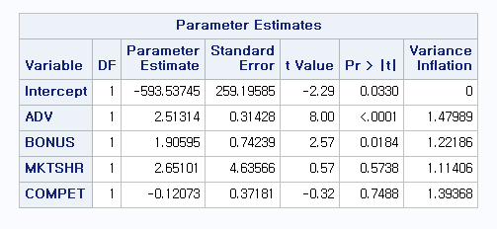
PROC REG;
MODEL SALES = ADV BONUS MKTSHR COMPET / VIF ;
RUN:
VIF > 10 ??
Multiple Regression II
Copyright © 2005 Brooks/Cole, a division of Thomson Learning, Inc.

Slide 40
4.6.3 Correction for Multicollinearity
One solution would be to leave out one or more of the redundant predictors.
>> Which one ? >> PCA (multivariate)
Another would be to use the variables differently. If x₁ and x₂ are collinear, you might try using x₁ and the ratio x₂/ x₁ instead.
Finally, there are specialized statistical procedures (Ridge Reg.) that can be used in place of ordinary least squares.
Multiple Regression II
Copyright © 2005 Brooks/Cole, a division of Thomson Learning, Inc.

Slide 41
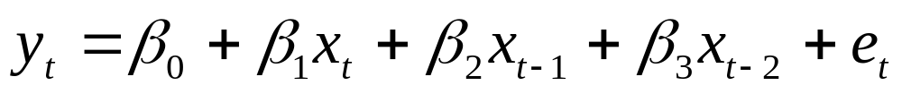
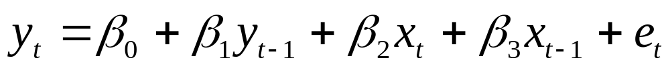
Another Examples for Correlated Predictors
Lagged Independent Variables
Lagged Dependent & Independent Variables
Multiple Regression II
Copyright © 2005 Brooks/Cole, a division of Thomson Learning, Inc.

Slide 42
4.7 Lagged Variables as Explanatory Variables in Time-Series Regression
When using time series data in a regression, the relationship between y and x may be concurrent or x may serve as a leading indicator.
In the latter, a past value of x appears as a predictor, either with or without the current value of x.
An example would be the relationship between housing starts as y and interest rates as x. When rates drop, it is several months before housing starts increase.
Multiple Regression II
Copyright © 2005 Brooks/Cole, a division of Thomson Learning, Inc.

Slide 43
Lagged Variables
The effect of advertising on sales is often cumulative so it would not be surprising see it modeled as:
Here x_{t} is advertising in the current month and the lagged variables x_{t-1} and x_{t-2} represent advertising in the two previous months.
Multiple Regression II
Copyright © 2005 Brooks/Cole, a division of Thomson Learning, Inc.

Slide 44
Potential Pitfalls
If several lags of the same variable are used, it could cause multicollinearity if x_{t} was highly autocorrelated (correlated with its own past values).
Lagging causes lost data. If x_{t-2} is included in the model, the first time it can be computed is at time period t = 3. We lose any information in the first two observations.
Multiple Regression II
Copyright © 2005 Brooks/Cole, a division of Thomson Learning, Inc.

Slide 45
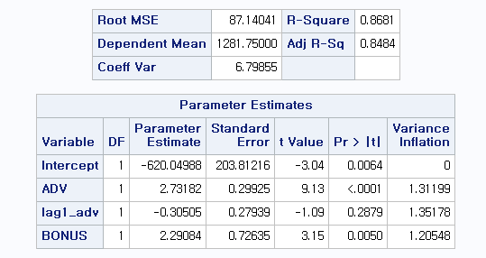
Data b ; set a ;
Lag1_adv = Lag1(ADV);
PROC REG data=b ;
MODEL SALES = ADV LAG1_ADV BONUS / VIF ;
RUN:
Multiple Regression II
Copyright © 2005 Brooks/Cole, a division of Thomson Learning, Inc.

Slide 46
Lagged y Values
Sometimes a past value of y is used as a predictor as well. A relationship of this type might be:
This implies that this month's sales y_{t} are related to by two months of advertising expense x_{t} and x_{t-1} plus last month's sales y_{t-1}.
Multiple Regression II
Copyright © 2005 Brooks/Cole, a division of Thomson Learning, Inc.

Slide 47
Example 4.6 Unemployment Rate
The file UNEMP4 contains the national unemployment rates (seasonally-adjusted) from January 1983 through December 2002.
On the next few slides are a time series plot of the data and regression models employing first and second lags of the rates.
Multiple Regression II
Copyright © 2005 Brooks/Cole, a division of Thomson Learning, Inc.

Slide 48
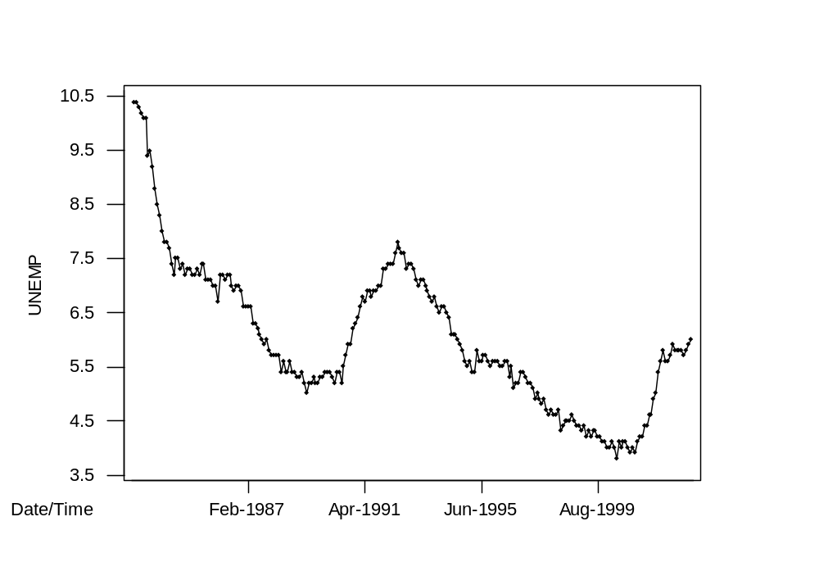



Time Series Plot
Autocorrelation is .97 at lag 1 and .94 at lag 2
Multiple Regression II
Copyright © 2005 Brooks/Cole, a division of Thomson Learning, Inc.

Slide 49
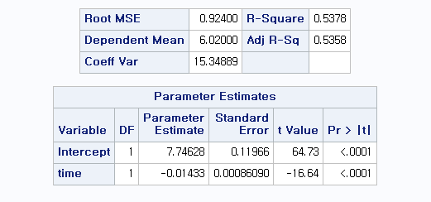
Trend Model
PROC REG;
MODEL UNEMP = TIME ;
RUN:
Multiple Regression II
Copyright © 2005 Brooks/Cole, a division of Thomson Learning, Inc.

Slide 50
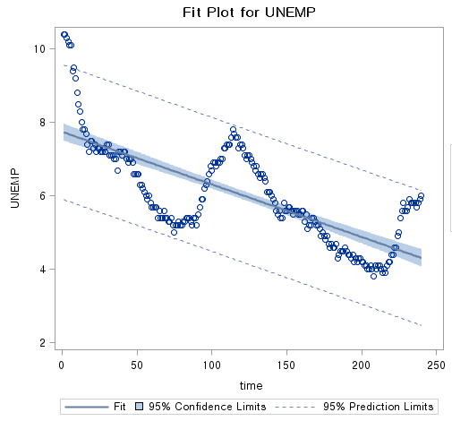
Not a good fit ! (R2 = 0.54)
Errors are not independent !
Multiple Regression II
Copyright © 2005 Brooks/Cole, a division of Thomson Learning, Inc.

Slide 51
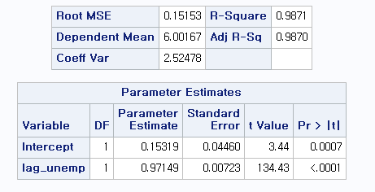
Regression With First Lag
DATA B; SET A;
LAG_UNEMP = LAG1(UNEMP);
PROC REG DATA=B;
MODEL UNEMP = LAG_UNEMP ;
RUN:
Multiple Regression II
Copyright © 2005 Brooks/Cole, a division of Thomson Learning, Inc.

Slide 52
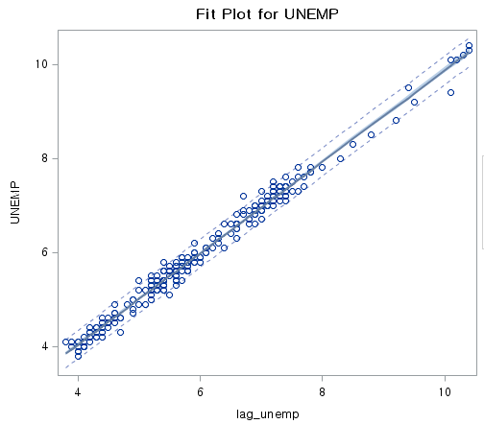
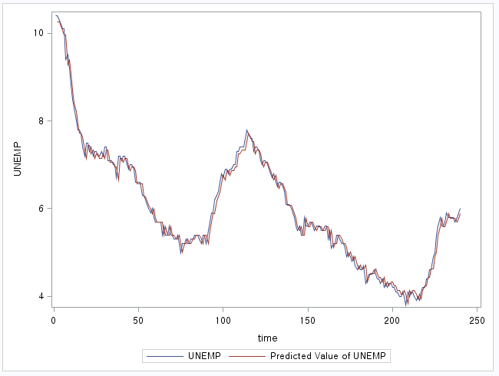
Good fit ! (R2 = 0.987)
Multiple Regression II
Copyright © 2005 Brooks/Cole, a division of Thomson Learning, Inc.

Slide 53
Regression With First Lag
The regression equation is
UNEMP = 0.153 + 0.971 Unemp1
239 cases used 1 cases contain missing values
Predictor Coef SE Coef T P
Constant 0.15319 0.04460 3.44 0.001
Unemp1 0.971495 0.007227 134.43 0.000
S = 0.1515 R-Sq = 98.7% R-Sq(adj) = 98.7%
Analysis of Variance
Source DF SS MS F P
Regression 1 414.92 414.92 18070.47 0.000
Residual Error 237 5.44 0.02
Total 238 420.36
High R² because of autocorrelation
Multiple Regression II
Copyright © 2005 Brooks/Cole, a division of Thomson Learning, Inc.

Slide 54
Regression With Two Lags
The regression equation is
UNEMP = 0.168 + 0.890 Unemp1 + 0.0784 Unemp2
238 cases used 2 cases contain missing values
Predictor Coef SE Coef T P VIF
Constant 0.16764 0.04565 3.67 0.000
Unemp1 0.89032 0.06497 13.70 0.000 77.4
Unemp2 0.07842 0.06353 1.23 0.218 77.4
S = 0.1514 R-Sq = 98.7% R-Sq(adj) = 98.6%
Analysis of Variance
Source DF SS MS F P
Regression 2 395.55 197.77 8630.30 0.000
Residual Error 235 5.39 0.02
Total 237 400.93
Multiple Regression II
Copyright © 2005 Brooks/Cole, a division of Thomson Learning, Inc.

Slide 55
Comments
It does not appear that the second lag term is needed. Its t statistic is 1.23.
Because we got R² = 98.7% from the model with just one term, there was not much variation left for the second lag term to explain.
Note that the second model also had a lot of multicollinearity.
Multiple Regression II
Copyright © 2005 Brooks/Cole, a division of Thomson Learning, Inc.

